Slide 1
ICE-PPR Situational Awareness Working Group Teleconference, 9/22/2022
P. McGillivary, USCG PACAREA Science Liaison
Comms & Navigation Updates
Photo: from POLAR STAR 2022 crossing the Pacific equator

Slide 2
Comms Updates: Starlink
NSF has installed Starlink at McMurdo Station: working very well. Can be used at two bandwidths: individual (high=50-200MB/sec downlink) and ‘project’ (higher=100-350MB/sec downlink).
Antennas are rated to -22ºF.
Starlink got FCC approval for Arctic operations in 2021, but the case was protested, however Starlink won a decision in August 2022, and plans COTS service in the Arctic in 2023.
Arctic service includes 41 satellites in polar orbit, w/ 61 optical relay satellites added in 2021, and V.2 satellites coming in 2023 that will provide downlink direct to smartphones via T-Mobile. [Another move being protested, so possibly delayed.]
SpaceX hits a milestone as Starlink internet arrives in Antarctica (interestingengineering.com)
Will be trying to get mobile system install on POLAR STAR for Antarctic ops this season, and HEALY for 2023 ops. The antennas are @$5-10K, and the service isn’t a contract, but rather pay-as-you-go, so we could just pay for the duration of these missions. CG would be happy to test for ONR!

Slide 3
Comms Updates: JADO in 2023
Lockheed will launch 3 small satellites in 2023 as a test of JADO ops (Joint All Domain Operations). These will be optically linked surveillance satellites (I believe using the same optical system used by Starlink).
These small satellites are intended to be a demo of ‘resilient’ surveillance & communication capability in case larger satellites were ‘damaged’.
These are intended as components of “21CS”, the 21st Century Security systems.
These three satellites comprise the SAJE (Space Augmented JADO Environmental) testbed.
Two of the satellites are Pony Express 2 satellites (see: https://www.nanosats.eu/sat/pony-express-2 ), which are Cubesats, and one is a Tactical Intelligence, Surveillance & Reconnaissance (ISR) comms satellite (presumably also a Cubesat). The two Pony Express satellites are scheduled for launch Dec. 31, 2022; NFI re dates for the other one – probably the same launch time.
The three satellites are intended to test use of RF communications to achieve swarm positioning.
The first capability test will be during the INDOPACOM Northern Edge exercise, in conjunction with USN Project Overmatch and US Army Project Convergence to demonstrate combined intel collection and communication.
CG D17 and MIFPAC are currently evaluating whether and how they could also use the intel and communications capabilities from these satellites during Northern Edge, which is a US-only joint DoD/CG field exercise conducted in odd years for interoperability training; CG provides one ship & C130.

Slide 4
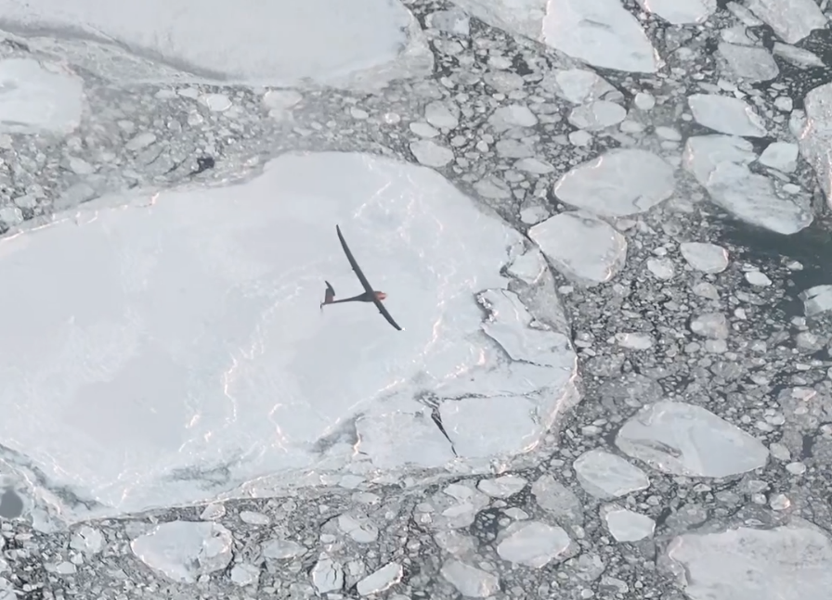
Comms Update: Iridium CERTUS for UxS
So, puck-sized Iridium CERTUS antennas were
supposed to have been completed @ a year ago,
but no evidence they have been. I will check with the company
But the VANILLA UAS, supported by an ONR Phase III SBIR (wingspan: 36’) the Iridium CERTUS transceiver weighed 26.2 oz ( lbs) during a winter 2021/2022 test flight out of Deadhorse testing an ice radar for NASA. VANILLA has potential endurance of up to 10 days; it is generally truck launched, but they also make a VTOL version.
See: https://www.iridium.com/case-studies/record-breaking-nasa-uav-mission-made-possible-with-midband-transceiver/

Slide 5
Navigation: eLORAN test, possible acronym… eL CAPITAN: eLORAN Communication for Autonomy, Position Information, Timing And Navigation
Per teleconf w Bridge Littleton of Hellen Systems, provided him a detailed eLORAN test scenario with two AUVs, one ASV and one UAS from UW APL, UC Davis, NEU and LDEO, respectively. The AUVs will test eLORAN penetration into water. A sub-goal will be to test optical comms with the new 10MB/sec Hydromea optical modems having @50m range (@$5K/each). The AF would like tests at both Lake Pend Oreille and Mountain Home AFB, @500mi away.
A secondary test would be needed to evaluate depth penetration in seawater and through sea ice. A test proposal was made for this at Svalbard, which will require use of at least one portable eLORAN system.
This test proposals were forwarded to the Air Force for their review prior to awarding Hellen systems the contract. Planned test dates: late 2022 or early 2023.

